Slide 1
Hadoop Map-Reduce NoSQL Database
By Akash Desai, Nihal Parchand, Viraj Chaudhari

Slide 2
Overview
Challenges:
Input data is too large (PetaBytes)
Straightforward repetitive work
Issues:
Recovering from machine failure
Debugging and Optimization
Communication and coordination
Locality
Scheduling

Slide 3
Limitations of RDBMS
Only structured Data
Average sized data (GBs)
Scalability (Vertical)
Licensed
Static schema (Pre-defined)
Eg: PostgreSQL, MySQL, Oracle, Microsoft SQL server etc.

Slide 4
Benefits of NoSQL
Structured, semi-structured and unstructured data
Large datasets (TBs and PBs)
Scalability (Horizontal)
Dynamic Schema
Eg: Cassandra, MongoDB, BigTable, HBase, Neo4j, CouchDB, MapReduce etc.

Slide 5
Introduction of Hadoop
Apache Open Source Framework
Stores large heterogeneous dataset on distributed system
Process data using MapReduce Framework
Data storage using Hadoop Distributed File System
Hive Query Language to access data
Different components - Hive, Pig, MapReduce, Mahout, Latin, Oozie, HDFS etc.

Slide 6
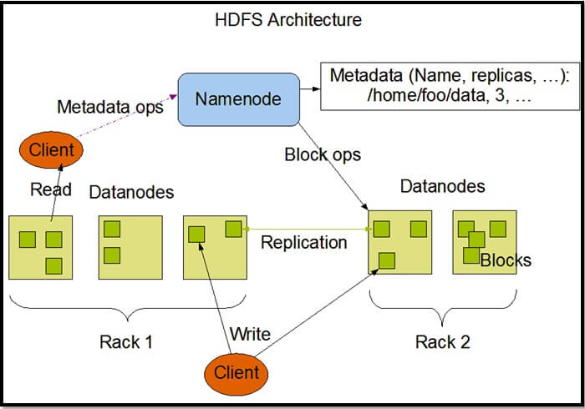
HDFS ARCHITECTURE
Image source: https://www.mssqltips.com/tipimages2/3180_HDFS_Architecture.jpg

Slide 7
Map-Reduce History
Popularized as programming model by Jeffery Dean and Sanjay Ghemawat in 2004.
Google used it to collect and analyze website data for search optimizations.
Apache started using map-reduce in the subproject Apache Lucern. Provides text search capabilities across large databases.
In 2007, Doug Cutting released Hadoop as open source Apache project.

Slide 8
RDBMS
Map-Reduce
Use B-Tree for updates
Many read/write operations continually
Structured data (XML documents/Tables)
Schema-on-write
Use Sort/Merge for updates
Write once, read many times
Semi-structured data (Spreadsheet) and unstructured data (plain text/image data)
Schema-on-read

Slide 9
Map-Reduce Overview
Simple programming model (Map + Reduce) that applies to many large-scale computing problems
Distributed implementation hides messy details:
Fault Tolerance
Parallelization
I/O Scheduling
Network and Disk transfer optimization

Slide 10
Map-Reduce Overview
Two types of nodes:
Cluster (Same local network and similar hardware)
Grid (Shared across geographically and heterogeneous hardware)
Data stored in :
Filesystem (Unstructured)
Database (Structured)

Slide 11
Map-Reduce Operations
Map - Process the I/P key-value pair and produce set of O/P intermediate key/value pairs.
map(in_key,in_value) -> list(out_key,interm_value)
Shuffle - Use sort/merge to combine intermediate results.
Reduce - Process the intermediate key/value, combine intermediate values for each unique key and generate a set of merged output values
reduce(out_key,interm_value) -> list(out_value)

Slide 12
Map-Reduce Programming Model
[input (key,value)]
[intermediate (key,value)]
[unique key,output value list]
Map function
Shuffle (merge sort by key)
Reduce function

Slide 13
Map-Reduce WordCount Example
Input
Split
Map
Shuffle
Reduce
Output
the small brown fox
a fox speaks to another fox
brown cow cross the road
<the,1>
<small,1>
<brown,1>
<fox,1>
<a,1>
<fox,1>
<fox,1>
<speaks,1>
<to,1>
<another,1>
<brown,1>
<cow,1>
<cross,1>
<the,1>
<road,1>
The small brown fox
A,1
another,1
brown,2
cross,2
cow,1
fox,3
Map
Reduce
a fox speaks to another fox
Map
road,1
small,1
speaks,1
the,2
to,1
Reduce
brown cow cross the road
Map

Slide 14
Map-Reduce WordCount Example (Combiner)
Input
Split
Map
Shuffle
Reduce
Output
the small brown fox
a fox speaks to another fox
brown cow cross the road
<the,1>
<small,1>
<brown,1>
<fox,1>
<a,1>
<fox,2>
<speaks,1>
<to,1>
<another,1>
<brown,1>
<cow,1>
<cross,1>
<the,1>
<road,1>
The small brown fox
A,1
another,1
brown,2
cross,2
cow,1
fox,3
Map
Reduce
a fox speaks to another fox
Map
road,1
small,1
speaks,1
the,2
to,1
Reduce
brown cow cross the road
Map

Slide 15
Map-Reduce Indexing
Index based on File URI
Indexed query will be equivalent to full scan query
Index based on InputSplit
Indexed query better than full scan.
Performance is optimized

Slide 16
Map-Reduce Performance
Optimized shuffle operation and writing only Map and Reduce function.
Combiner - reduce data written to disk
Complexity of mapping, shuffle, sorting, and reducing
Fault Tolerance can be handled by re-execution
Worker failure
Master failure

Slide 17
Map-Reduce Refinement
Redundant execution
Skipping bad records
Backup tasks
Locality optimization
Optional secondary keys for ordering

Slide 18
Transaction Management
ACID
Atomicity
Consistency
Isolation
Durability
BASE
Basically available
Soft state
Eventual consistency

Slide 19
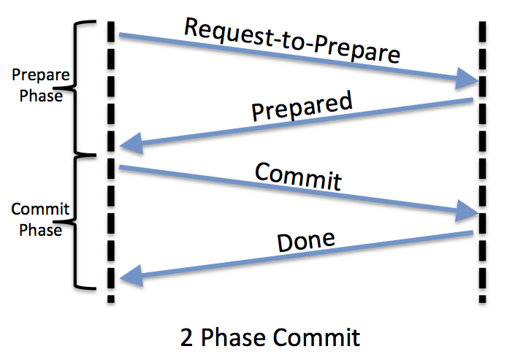
2 PHASE COMMIT PROTOCOL
Image source: https://www.tigerteam.dk/wp-content/uploads/2014/03/2-phase-commit-protocol-flow.png

Slide 20
Map-Reduce Uses
Distributed pattern-based searching
Distributed sorting
Web link-graph reversal
Inverted index construction
Document clustering

Slide 21
Application
Cloudera VM-Oracle Virtual Box virtualization software provides the HDFS instances as well as all the services in the Hadoop framework, which can be installed separately. The components include the HDFS file system, Hive, Impala, MapReduce, PigLatin.
CentOs operating system provides terminal support.
City database as an input with columns - ID, Name, CountryCode, District, Population. The database is stored as a CSV input in the HDFS folder.
We implemented java code, which takes SQL queries as an input and generates output using MapReduce Framework.

Slide 22
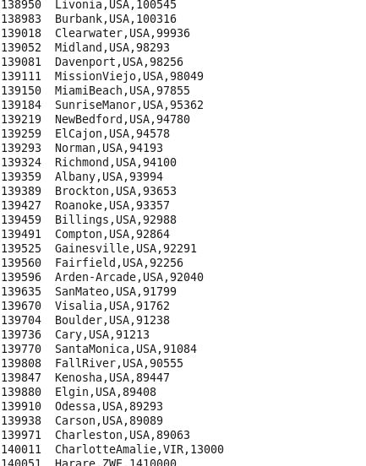
RESULT
select name, countrycode, population from city

Slide 23
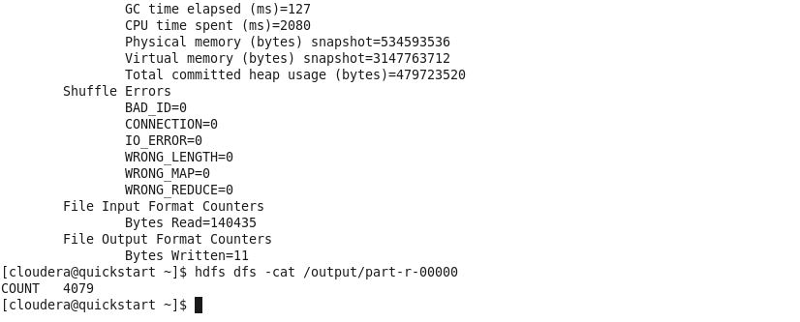
RESULT
select count(*) from city

Slide 24
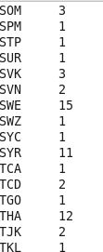
RESULT
select count(*) from city group by countrycode

Slide 25
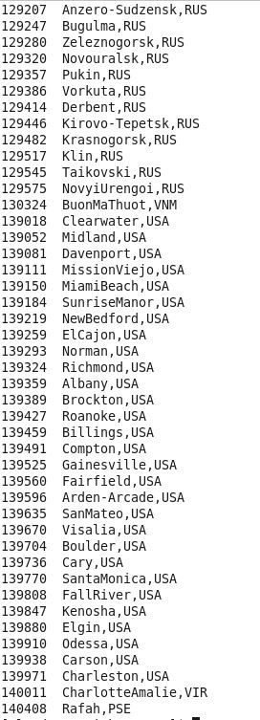
RESULT
. select name, countrycode from city where
population < 100000

Slide 26
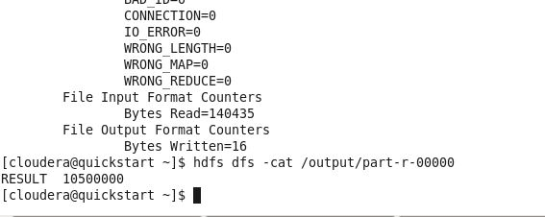
RESULT
select MAX(population) from city

Slide 27
Conclusion
Inexpensive (Free to use)
Hides all the messy details- Implement only Map and Reduce functions
Provides easy model to implement parallel programs
Performance of MapReduce is better when the volume of data is large i.e. in PetaBytes.

Slide 28
References
MapReduce: Simplified Data Processing on Large Clusters
https://static.googleusercontent.com/media/research.google.com/en//archive/mapreduce-osdi04.pdf
HADOOP vs RDBMS|Know The 12 Useful Differences
https://www.educba.com/hadoop-vs-rdbms/
Hadoop: The Definitive Guide
https://en.wikipedia.org/wiki/MapReduce
https://hadoopi.wordpress.com/2013/05/24/indexing-on-mapreduce-2/
https://www.slideshare.net/rantav/introduction-to-map-reduce

Slide 29
Thank You

